Slide 1
JDI COMPOSITE ELEMENTS

Slide 2

PLAN
UI Objects. JDI
JDI. Composite elements
JDI Settings
JDI for any UI

Slide 3
AGENDA
All Composite elements
Site Structure
UI Objects

Slide 4
Composite elements

Slide 5
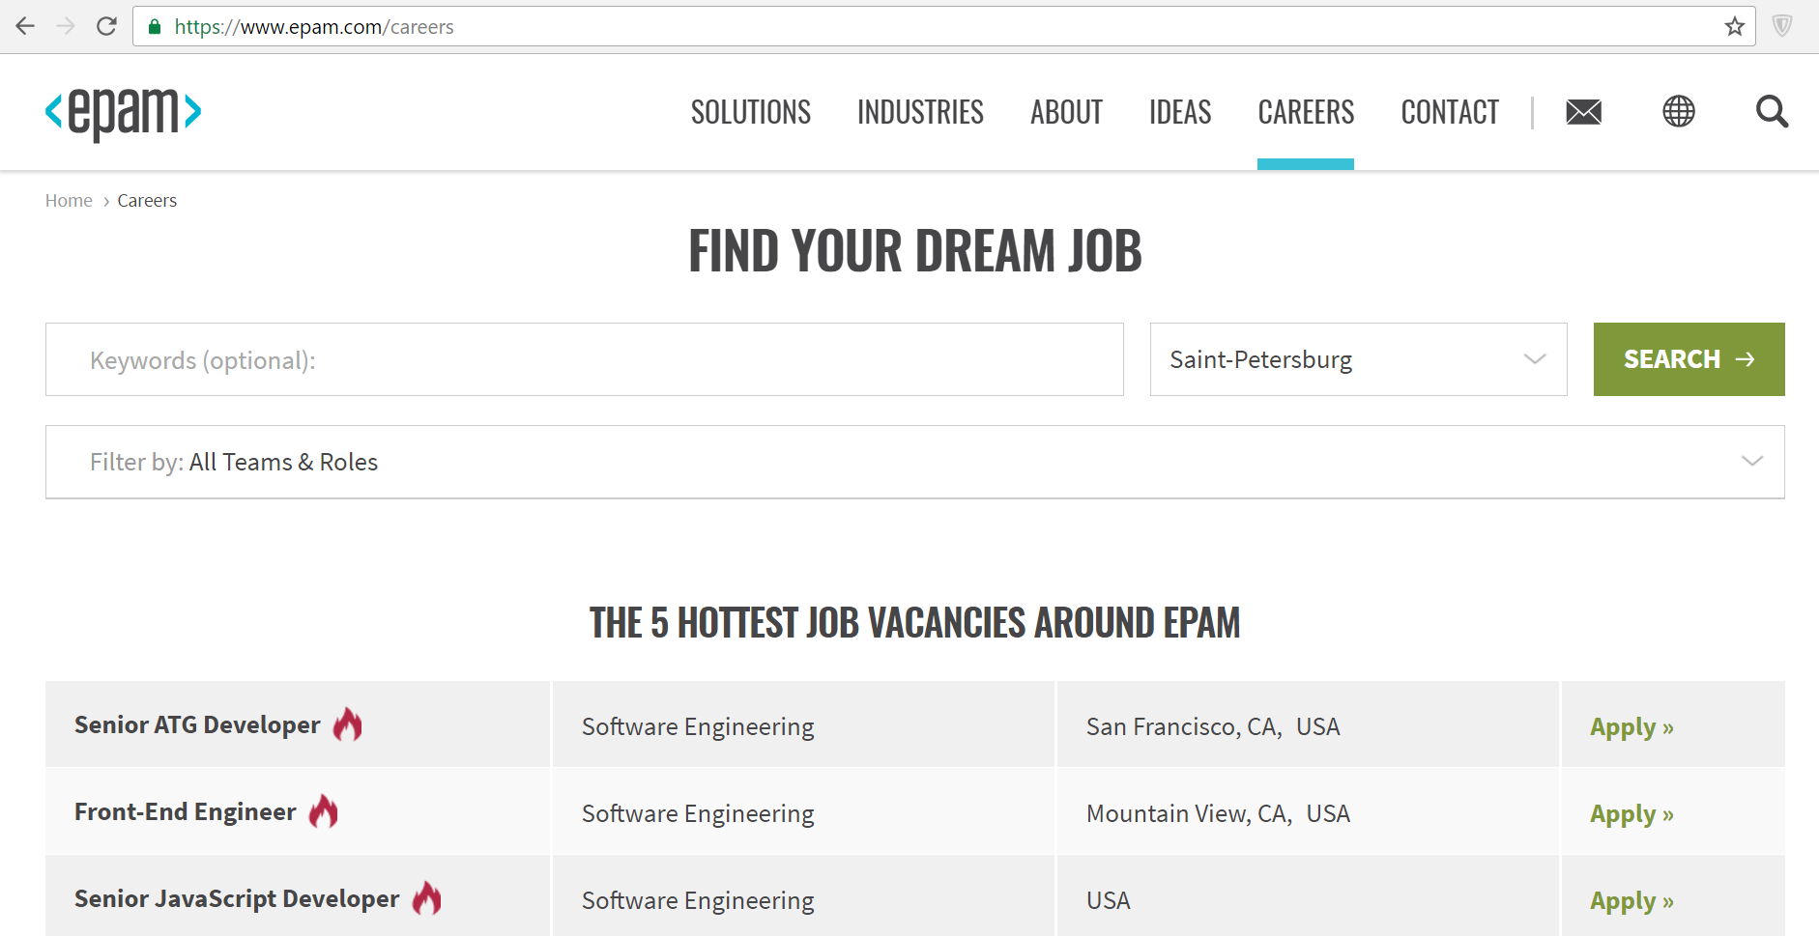
Page structure

Slide 6
Ui objects
ContactPage (Page)
ContactForm (Form) Name(TextField)
Location (Dropdown)
Message (TextArea)
SubmitButton(Button)
-> Save as Draft
-> Submit
Description (Text)
Header (Section)
ContactForm Name(TextField)
Location (Dropdown)
Message (TextArea)
SubmitButton(Button)
-> Save as Draft
-> Submit
ContactPage
ContactForm Name(TextField)
Location (Dropdown)
Message (TextArea)
SubmitButton(Button)
-> Save as Draft
-> Submit
Description (Text)
Header

Slide 7
Structure
EpamSite (Site)
HomePage(Page)
SearchSection (Search)
SearchField(TextField)
SearchButton(Button)
Invitation(Text)
ContactPage(Page)
ContactForm(Form)
…
Description(Text)
@BeforeSuite(alwaysRun = true)
public static void setUp() {
WebSite.init(EpamSite.class);
}

Slide 8
composite Elements
public class Header extends Section
public class LoginForm extends Form
public class SearchBar extends Search
public class Alert extends Popup
public class Navigation extends Pagination
@JSite(domain = “http://epam.com/")
public class EpamSite extends WebSite
@JPage(url = "/index.html", title = “Good site")
public class HomePage extends WebPage
public class Header extends Section
public class LoginForm extends Form
public class SearchBar extends Search
public class Alert extends Popup
public class Navigation extends Pagination
domain=https://www.epam.com/

Slide 9
WEB site
@JSite(domain = “http://epam.com/")
public class EpamSite extends WebSite {
@JPage(url = "/index.html")
public static HomePage homepage;
@JPage(url = "/login", title = “Login page")
public static LoginPage loginPage;
@FindBy (css=“.nav”)
public static Menu navigation;
}
@BeforeSuite(alwaysRun = true)
public static void setUp() {
WebSite.init(EpamSite.class);
}

Slide 10
Section
public class Header extends Section {
@FindBy (css=“.submit”)
public Button submit;
@FindBy (css=“.followMe”)
public Link followMe;
@FindBy (css=“.navigation”)
public Menu navigation;
public void openAbout() {
followMe.Click();
navigation.select(ABOUT);
}
}
USAGE
header.submit.Click();
header.menu.isSelected();
header.openAbout();

Slide 11
Section
@JSite(domain = “http://epam.com/")
public class EpamSite extends WebSite {
@FindBy(id = “header”)
public static Header header;
…
}
USAGE
header.submit.Click();
public class Header extends Section {
@FindBy (css=“.submit”)
public Button submit;
@FindBy (css=“.followMe”)
public Link followMe;
@FindBy (css=“.navigation”)
public Menu navigation;
}
driver
.findElement(By.id(“header”))
.findElement(By.css(“.submit”)).click()

Slide 12
WEB PAGE
@JPage(url = "/main", title = "Good site", urlTemplate = “/main?\d{10}“, urlCheckType = MATCH, titleCheckType = CONTAINS)
public class HomePage extends WebPage
USAGE
homepage.open();
homepage.checkOpened();
homepage.isOpened();
homepage.refresh();
homepage.back();
homepage.forward();
homepage.addCookie();
homepage.clearCache();

Slide 13

Demo: CREATE SITE
Notes:
LIVE demo
Есть готовые UI Objects. Переделка Селениум кода (с вейтами) под UI объекты

Slide 14
Entity driven testing

Slide 15






EDT: DATA DRIVEN TESTING
Provide List<User> for test

Slide 16


EDT: PRECONDITIONS
Provide List<User> for test
0. Have DefaultUser in DB
?
+

Slide 17

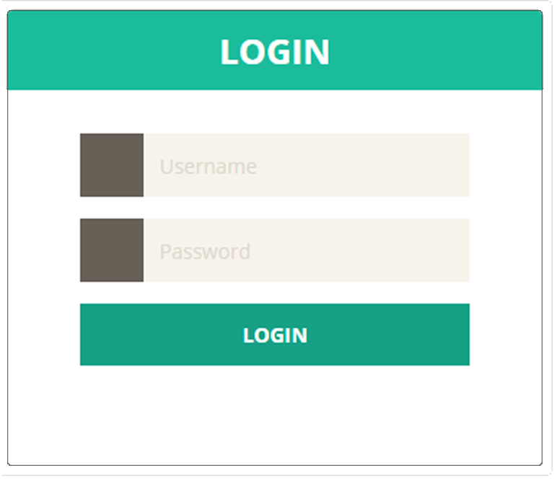
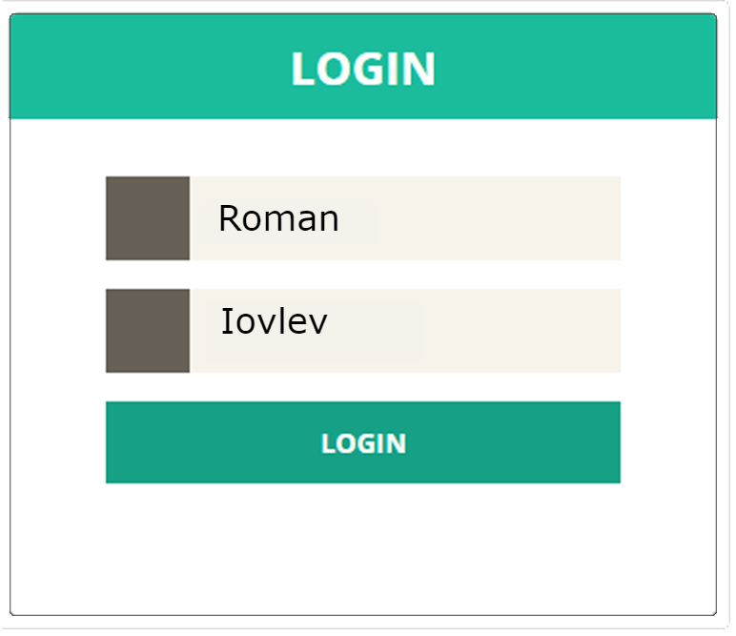
EDT: FILL AND SUBMIT
Provide List<User> for test
0. Have DefaultUser in DB
Login with DefaultUser

Slide 18

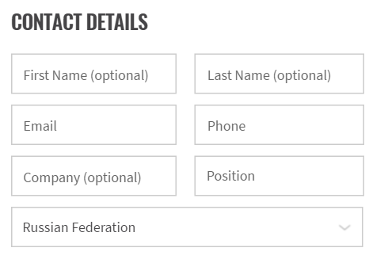
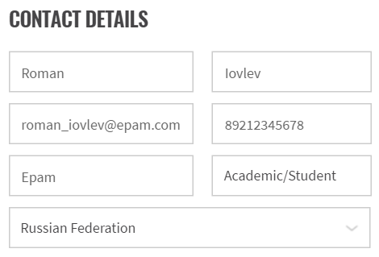
EDT: FILL AND SEND
Provide List<User> for test
0. Have DefaultUser in DB
Login with DefaultUser
Submit Contact Us Form for DefaultUser

Slide 19

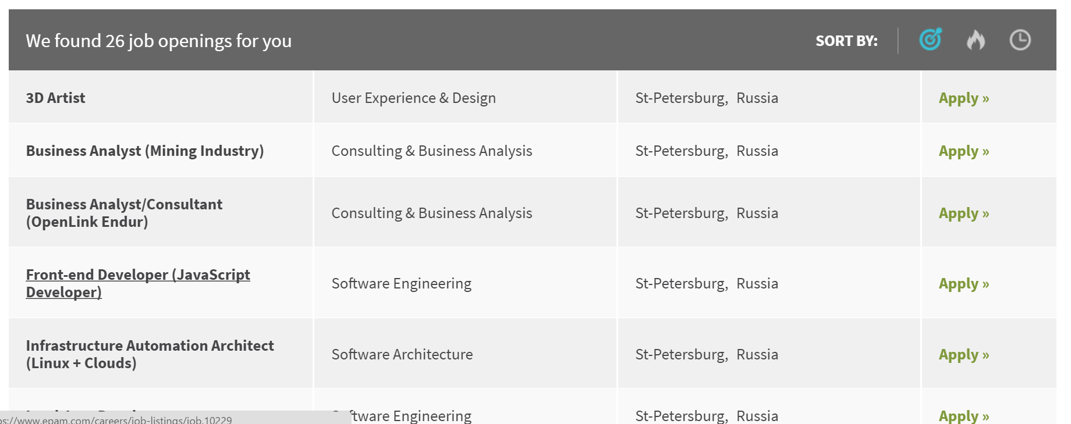

EDT: EXTRACT
Provide List<User> for test
0. Have DefaultUser in DB
Login with DefaultUser
Submit Contact Us Form for DefaultUser
Get Act. Opening from Vacancy table

Slide 20

EDT: VALIDATE
Provide List<User> for test
0. Have DefaultUser in DB
Login with DefaultUser
Submit Contact Us Form for DefaultUser
Get Act. Opening from Vacancy table
Assert Act. Opening equals to Exp. Opening
Actual
Expected

Slide 21
FORM
public class LoginForm extends Form<User> {
@FindBy (css=“.login”)
public TextField login;
@FindBy (css=“.psw”)
public TextField password;
@FindBy (css=“.submit”)
public Button submit;
@FindBy (css=“.cancel”)
public Button cancel;
}
public class User {
public String login = “roman”;
public String password = null;
}
@Test
public class simpleTest(User user) {
loginForm.login(user);
…
}

Slide 22
Entity driven testing
@Test
public void formTest(User admin) {
loginForm.loginAs(admin);
filter.select(admin.name);
Assert.each(results).contains(admin.name);
admin.update(results.get(1));
payForm.submit(admin.creditCard);
Assert.areEquals(DB.transactions.get(1),
admin.creditCard);
}
USAGE
loginForm.fill(user);
loginForm.submit(user);
loginForm.verify(user);
loginForm.check(user);
loginForm.cancel(user);
loginForm.save(user);
loginForm.publish(user);
loginForm.search(user);
loginForm.update(user);
…

Slide 23
Demo: forms
Notes:
LIVE demo
Есть готовые UI Objects. Переделка Селениум кода (с вейтами) под UI объекты

Slide 24

more Complex elements
public class SearchBar extends Search { }
public class Navigation extends Pagination { }
public class Confirmation extends Popup { }
…
public class ContactConfirm extends Confirmation { }
// implements IComposite
Homework

Slide 25
Ui objects pattern

Slide 26

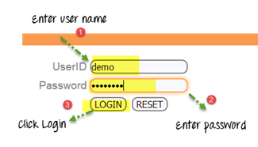
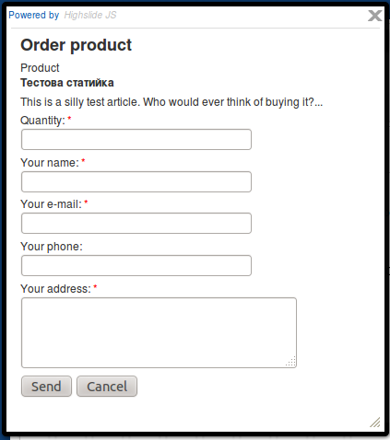
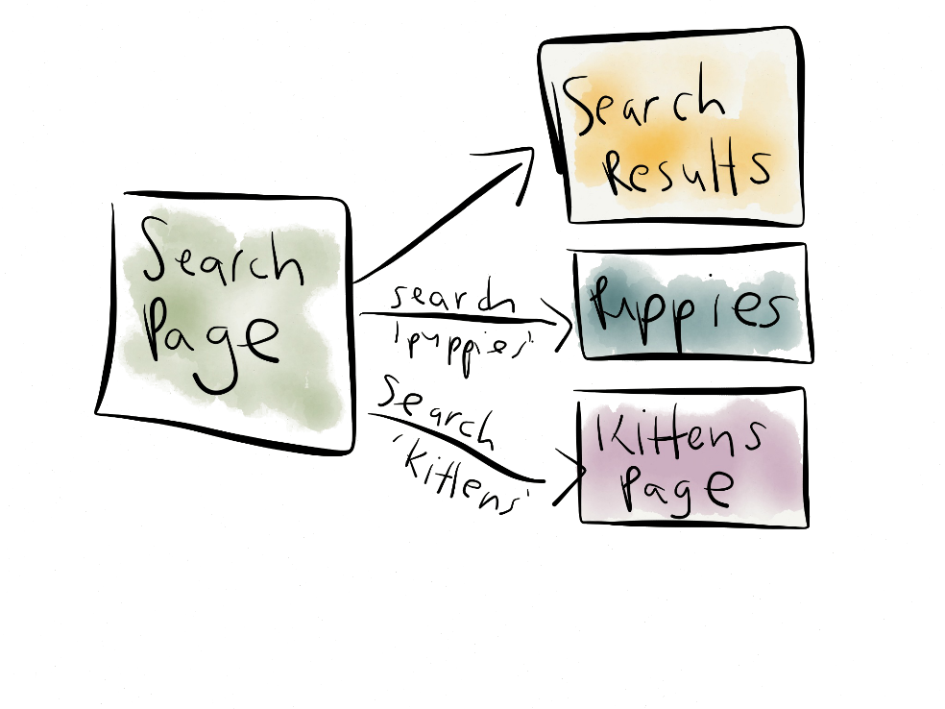
UI Objects
Popular test pattern
Page Objects

Slide 27
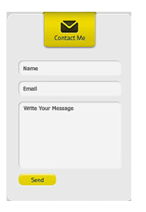


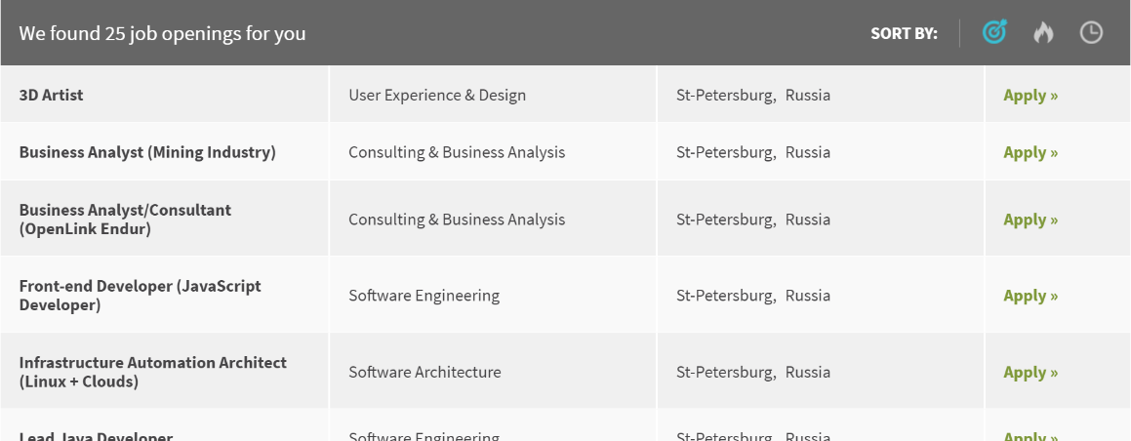
UI Objects
Useful test approach
UI Elements

Slide 28



UI Objects
Flexible implementation
Interfaces

Slide 29
UI Objects
Page Objects
UI Elements
UI OBJECTS
Interfaces

Slide 30
PLAN
UI Objects. JDI
JDI. Composite elements
JDI Settings
JDI for any UI

Slide 31



Questions
roman.Iovlev
roman_iovlev@epam.com

